Slide 1


Capstone project phase A
Project no. 24-2-D-30
Weather Catastrophe prediction
Supervisor: Dr. Zakharia Frenkel
Students: Nermeen Basila
Madi Swead

Slide 2

introduction
This project investigates the rising frequency and intensity of catastrophic weather events, such as hurricanes and floods, in the context of climate change.
By analysing historical weather data and key meteorological variables, we aim to identify patterns that contribute to these extreme phenomena.
Our goal is to enhance predictive models and develop effective strategies for community preparedness and resilience against severe weather conditions.

Slide 3


Catastrophe definition and Reasons
Catastrophe in general
Catastrophe in our concept
Catastrophe reasons

Slide 4

Challenges in Predicting Catastrophe Weather Events
Understanding the Complexity and Impact of Inaccurate Predictions
Multiple Variables
Data Quality and Availability
Model Limitations
Computational Complexity

Slide 5
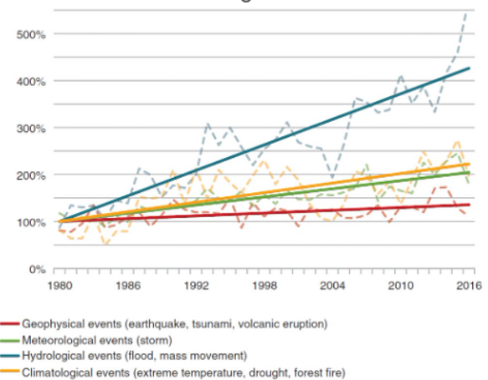
How have catastrophe weather events evolved , and why is it important to study them ?

Slide 6

Here are some algorithms commonly used in the prediction of catastrophic weather events:
Long Short-Term Memory (LSTM) Networks
Artificial Neural Networks
(ANN)
Support Vector Machines
(SVM)
Convolutional Neural Networks
(CNN)

Slide 7

Here are parameters used in the analysis and prediction of catastrophic weather events:
Dewpoint
Wind Speed
Temperature
Atmospheric
Sea Surface Temperature
Humidity
Historical Data Trends
Geopotential Height
Rainfall

Slide 8


Slide 9
Why our algorithm is better
Structured Grid-Based Approach
Clear Definition of Catastrophic Metrics
Direct Calculation of Parameters
Trajectory Building for Catastrophic Events
Manual Analysis and Expert Judgment

Slide 10
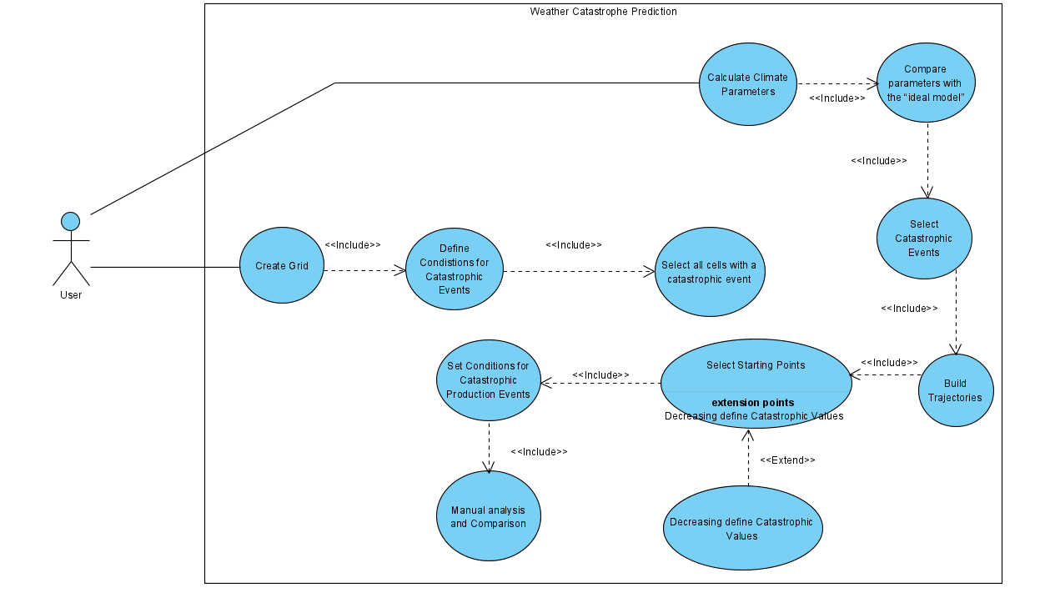
Use case diagram

Slide 11
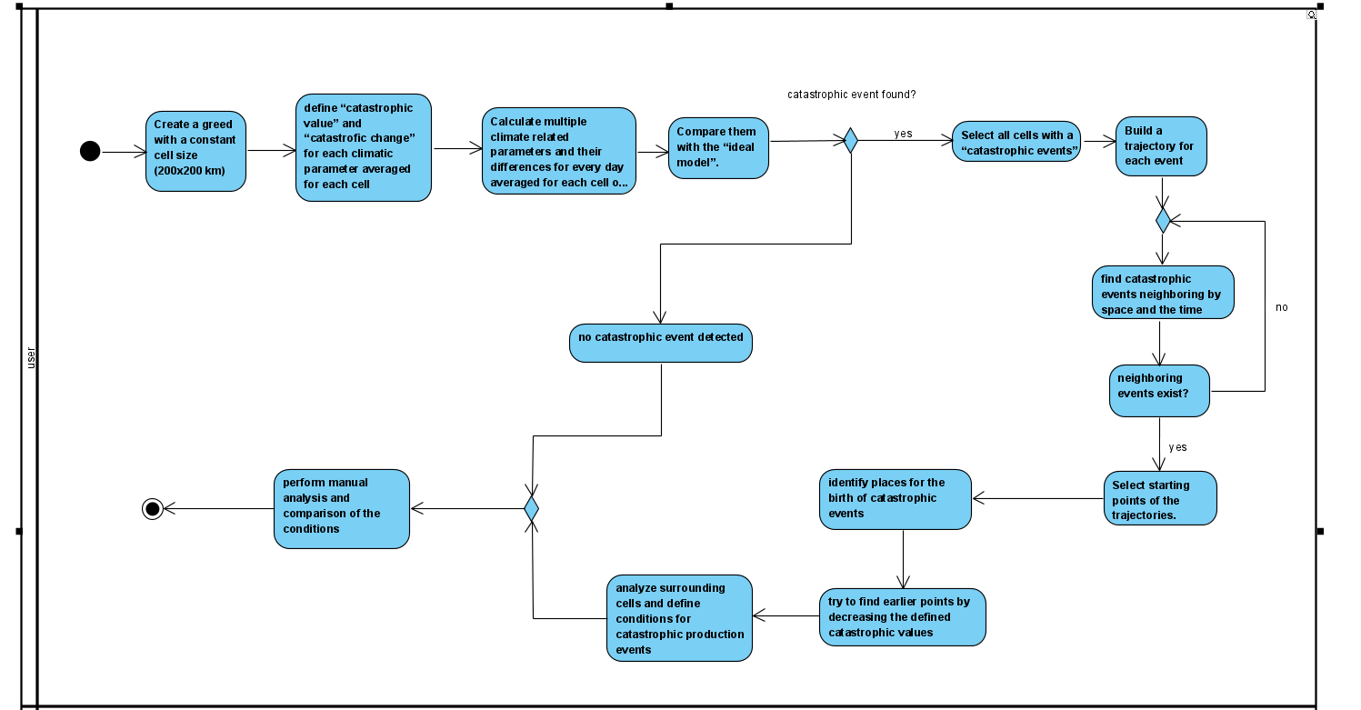
Activity diagram

Slide 12

Expectation
Defining the Goals for Enhancing Weather Catastrophe Prediction :
Improved Prediction Accuracy
Enhanced Data Integration
Increased Understanding of Weather Patterns
Algorithm Development and Innovation
Contribution to Climate Change Adaptation Efforts

Slide 13


